Slide 1
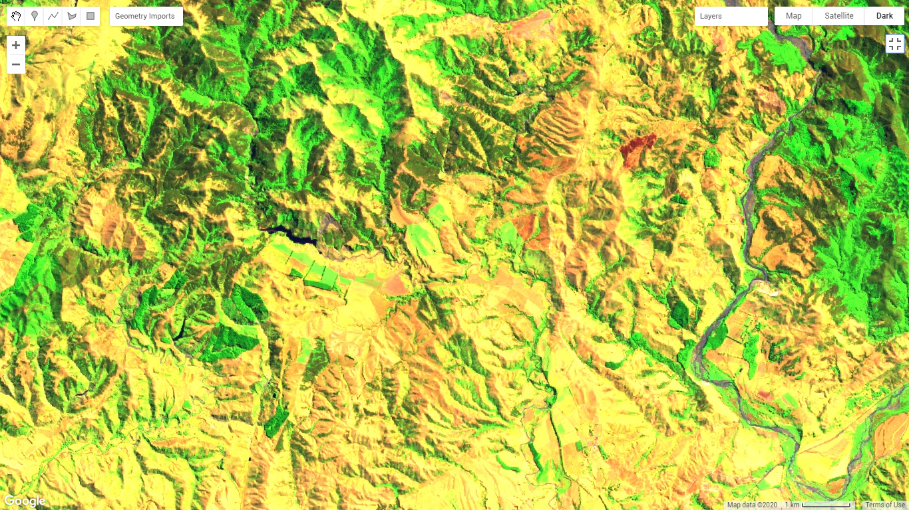

Mapping and monitoring of landslide-dammed lakes using Sentinel-2 time series A case study after the 2016 Kaikōura Earthquake in New Zealand
Lorena Abad¹
Daniel Hölbling¹
Raphael Spiekermann²
Zahra Dabiri¹
Günther Prasicek^{3,4}
Anne-Laure Argentin³
¹Department of Geoinformatics - Z_GIS, University of Salzburg, 5020 Salzburg, Austria
²Manaaki Whenua - Landcare Research, Palmerston North 4442, New Zealand
³Department of Geography and Geology, University of Salzburg, 5020 Salzburg, Austria
⁴Center for Interdisciplinary Mountain Research, University of Lausanne, 1967 Bramois, Switzerland
Session NH6.1 – Live chat: Thu, 07 May, 14:00–15:45

Slide 2








Introduction
Motivation
Dammed lakes are a potential natural hazard due to ﬂooding risk.
Monitoring landslide dams and their related lakes is important for disaster management.
Field measurements and observations provide detailed information but are time-consuming and expensive, mainly for large areas.
Aerial photographs and LiDAR data are valuable data sources, but time series for constant monitoring are hardly available.
Satellite remote sensing imagery, like Sentinel-2, has become essential to obtain a large overview of hardly accessible areas.
Objectives
Detect and map landslide-dammed lakes with Sentinel-2 imagery on Google Earth Engine (GEE).
Monitor dammed lake evolution in different time periods.
Apply the automated method for the 2016 Kaikōura earthquake in New Zealand.

Slide 3
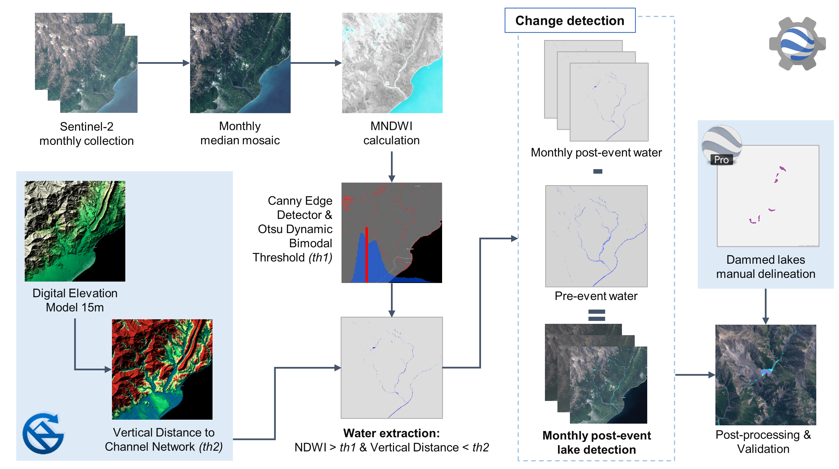
Methodology
The lake detection method applied on GEE can be summarized in 4 basic steps:
Monthly mosaic and MNDWI calculation from Sentinel-2 imagery.
Monthly water extraction ^{[1]} based on vertical distance to the channel network and NDWI thresholding.
Differencing change detection of water layers using pre- and post-event mosaics.
Post-processing and validation of detected dammed-lakes.

Slide 4
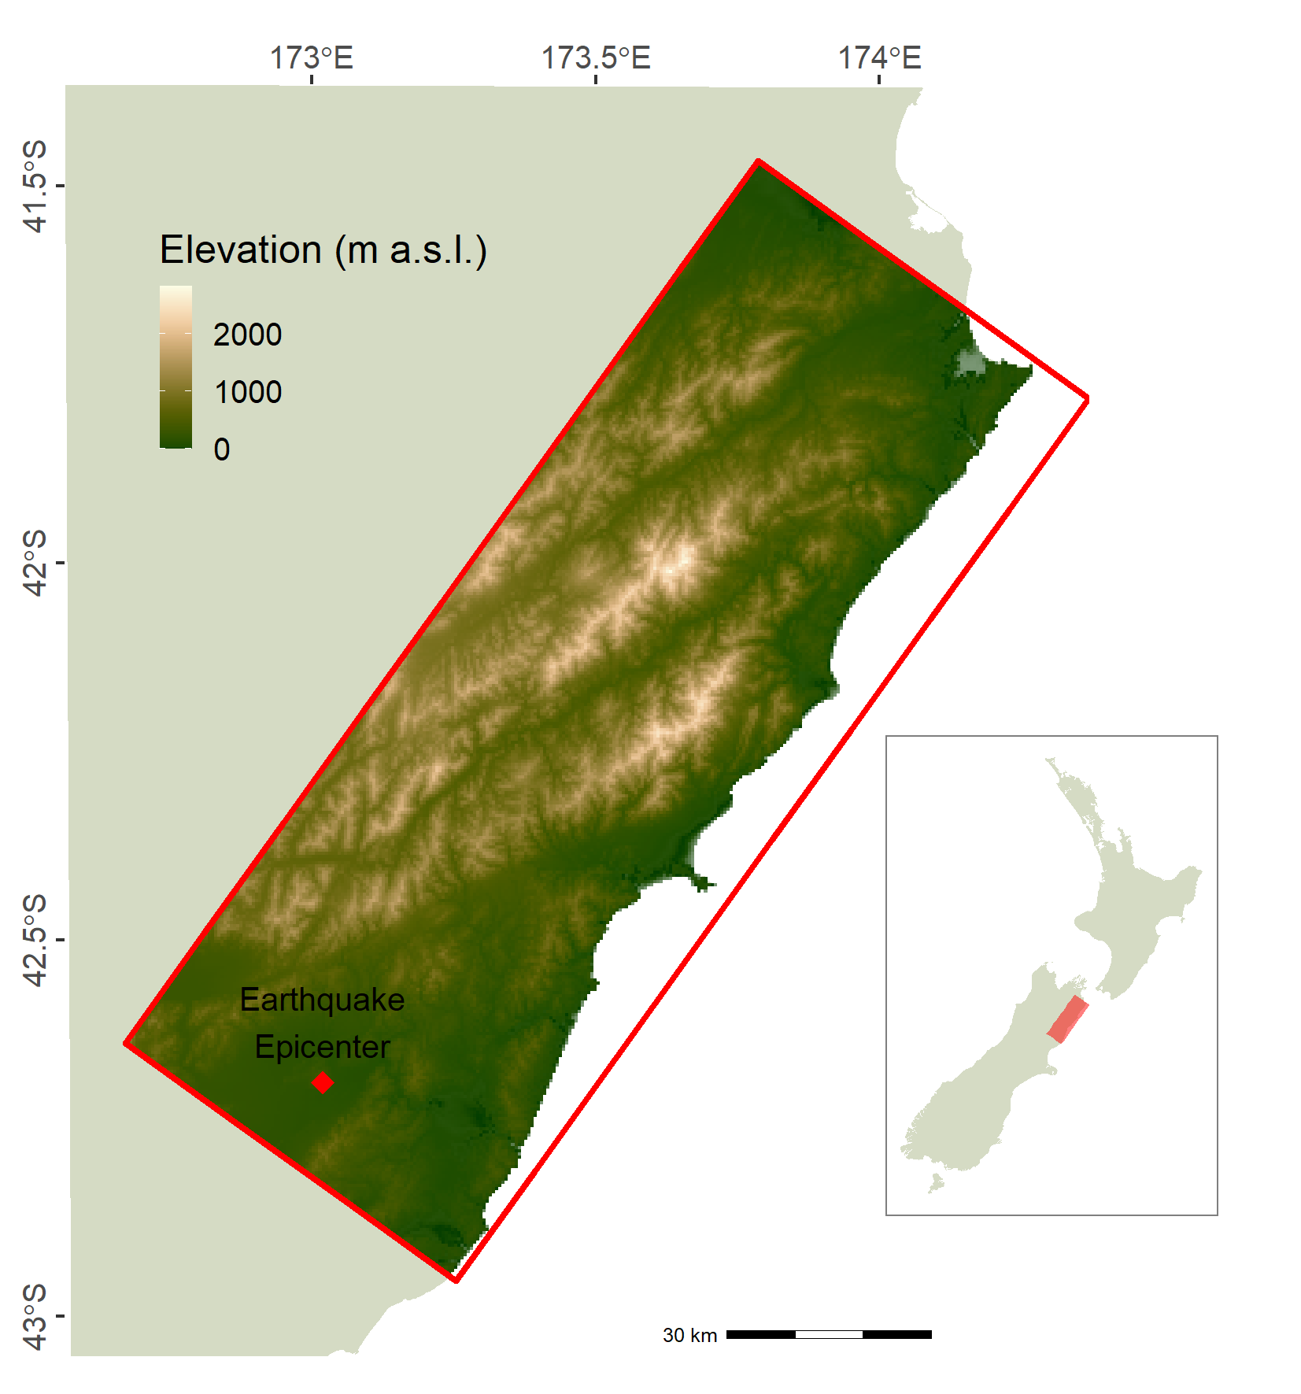



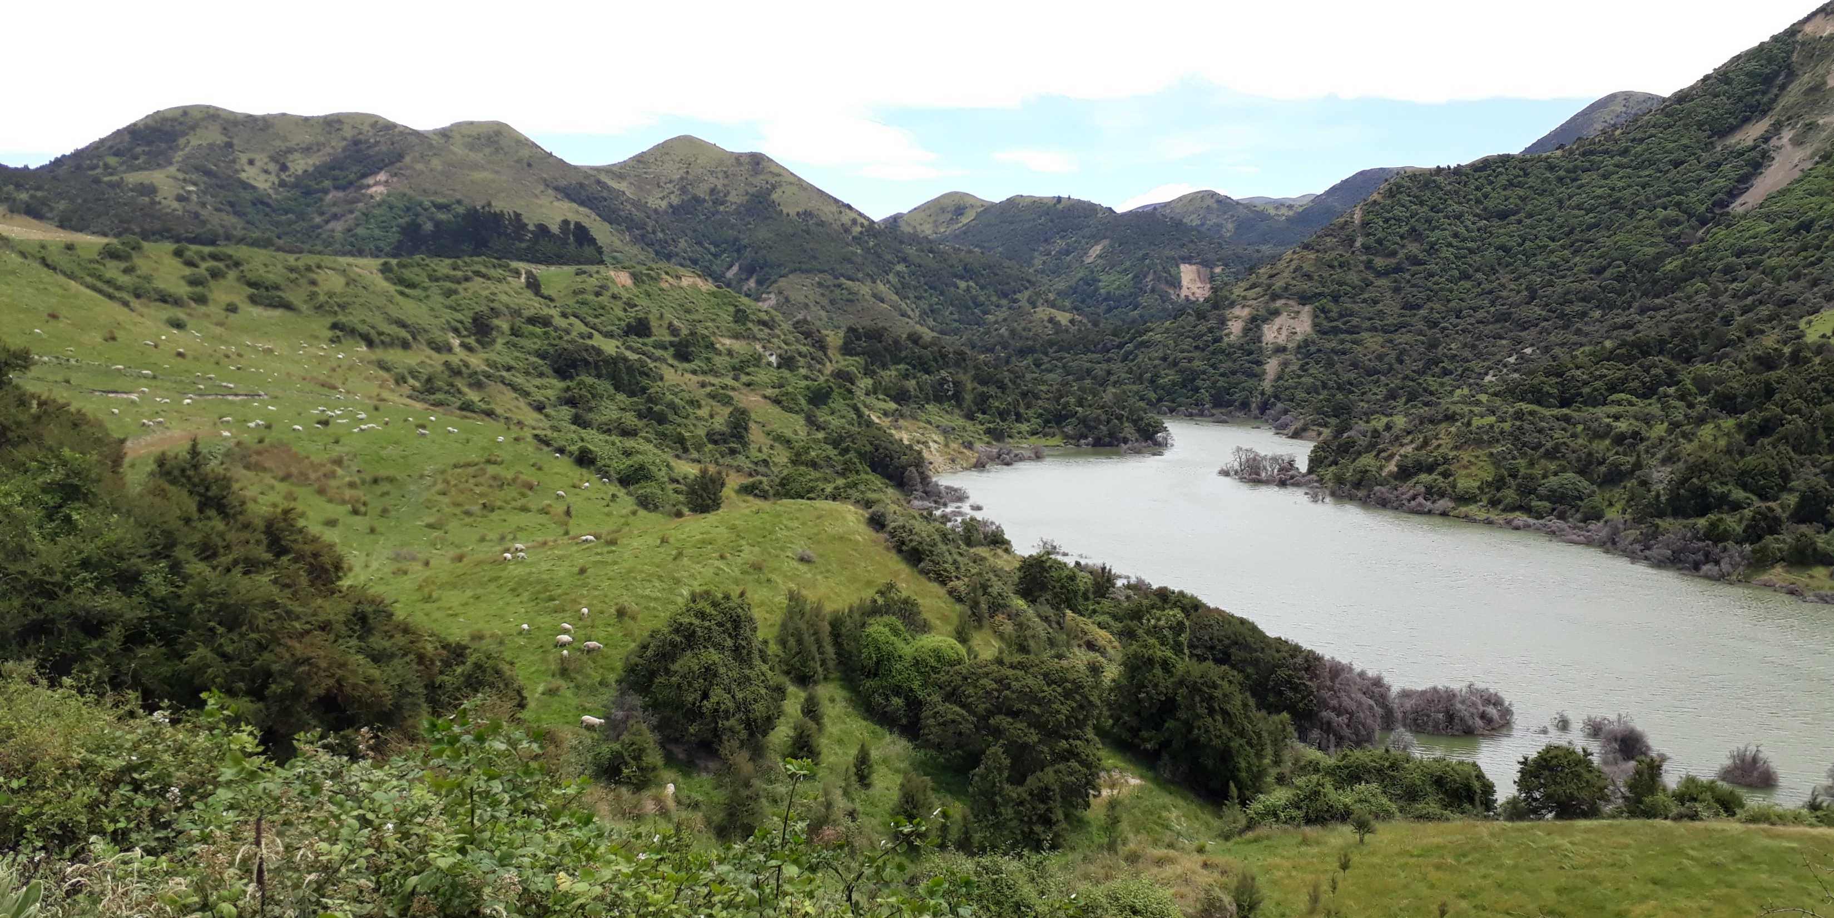
Case study background
On Nov. 14th, 2016, a 7.8 M_{W} earthquake hit the Kaikōura region in New Zealand.
Over 10,000 co-seismic landslides affected the area^{[2]}.
Approx. 200 landslide-dammed lakes were formed.
Study area: 9,600 km²
Lake formed at the Leader river dam. Ph. A.-L. Argentin, Jan. 2019

Slide 5
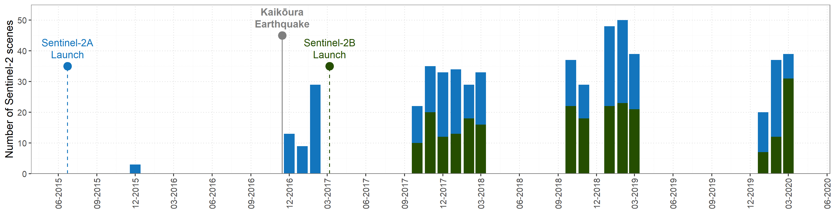
Method application and validation
One pre-event and 17 post-event monthly mosaics were composed on GEE, selecting scenes with cloud coverage below 30%. The analysis considered imagery from October to March. A mosaic was used for analysis when the study area was completely covered. The launch of Sentinel-2B increased the number of available scenes significantly.
For validation, the detected lakes for December 2016 were overlapped with lakes delineated manually on Google Earth Pro for the imagery available immediately after the earthquake. 28 out of 39 lakes were successfully detected with the automated method. Undetected lakes are due to topographic shadows on highly mountainous terrain.
72%
detection rate

Slide 6
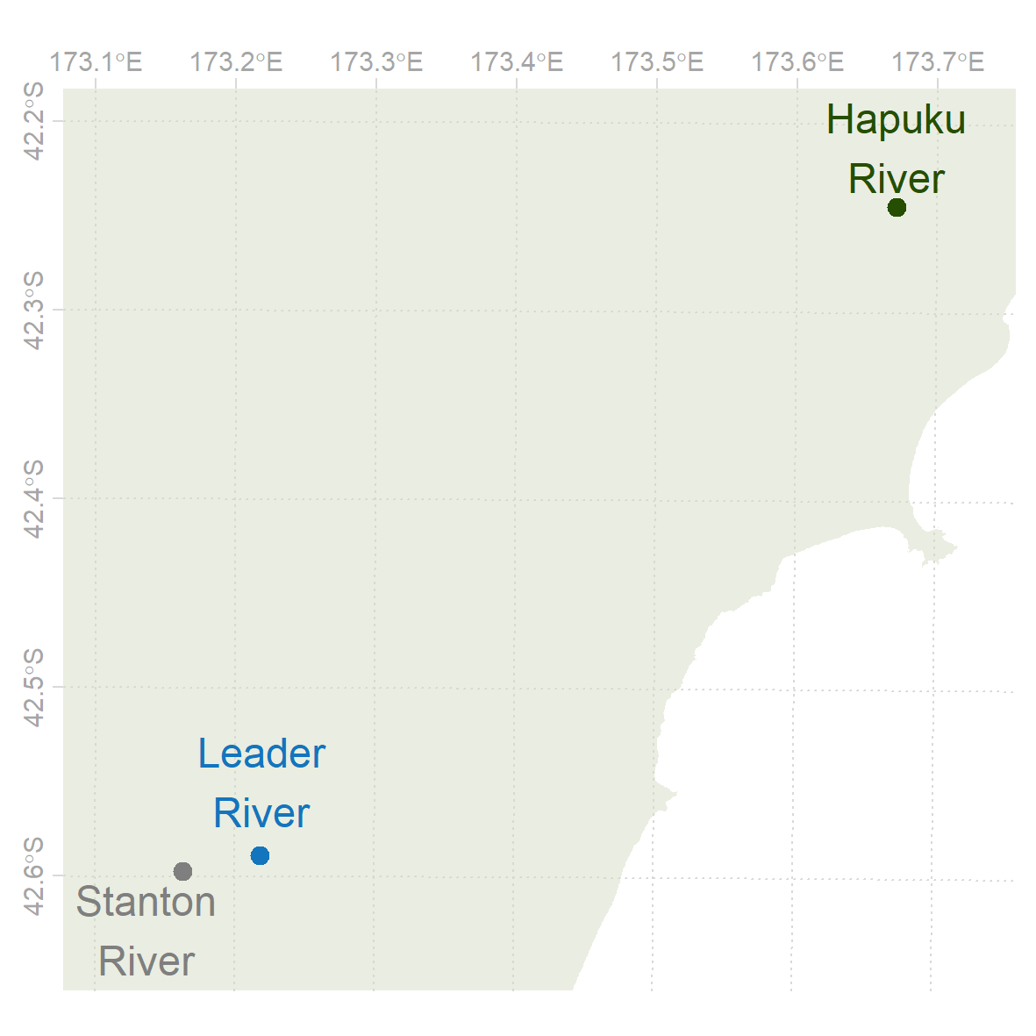
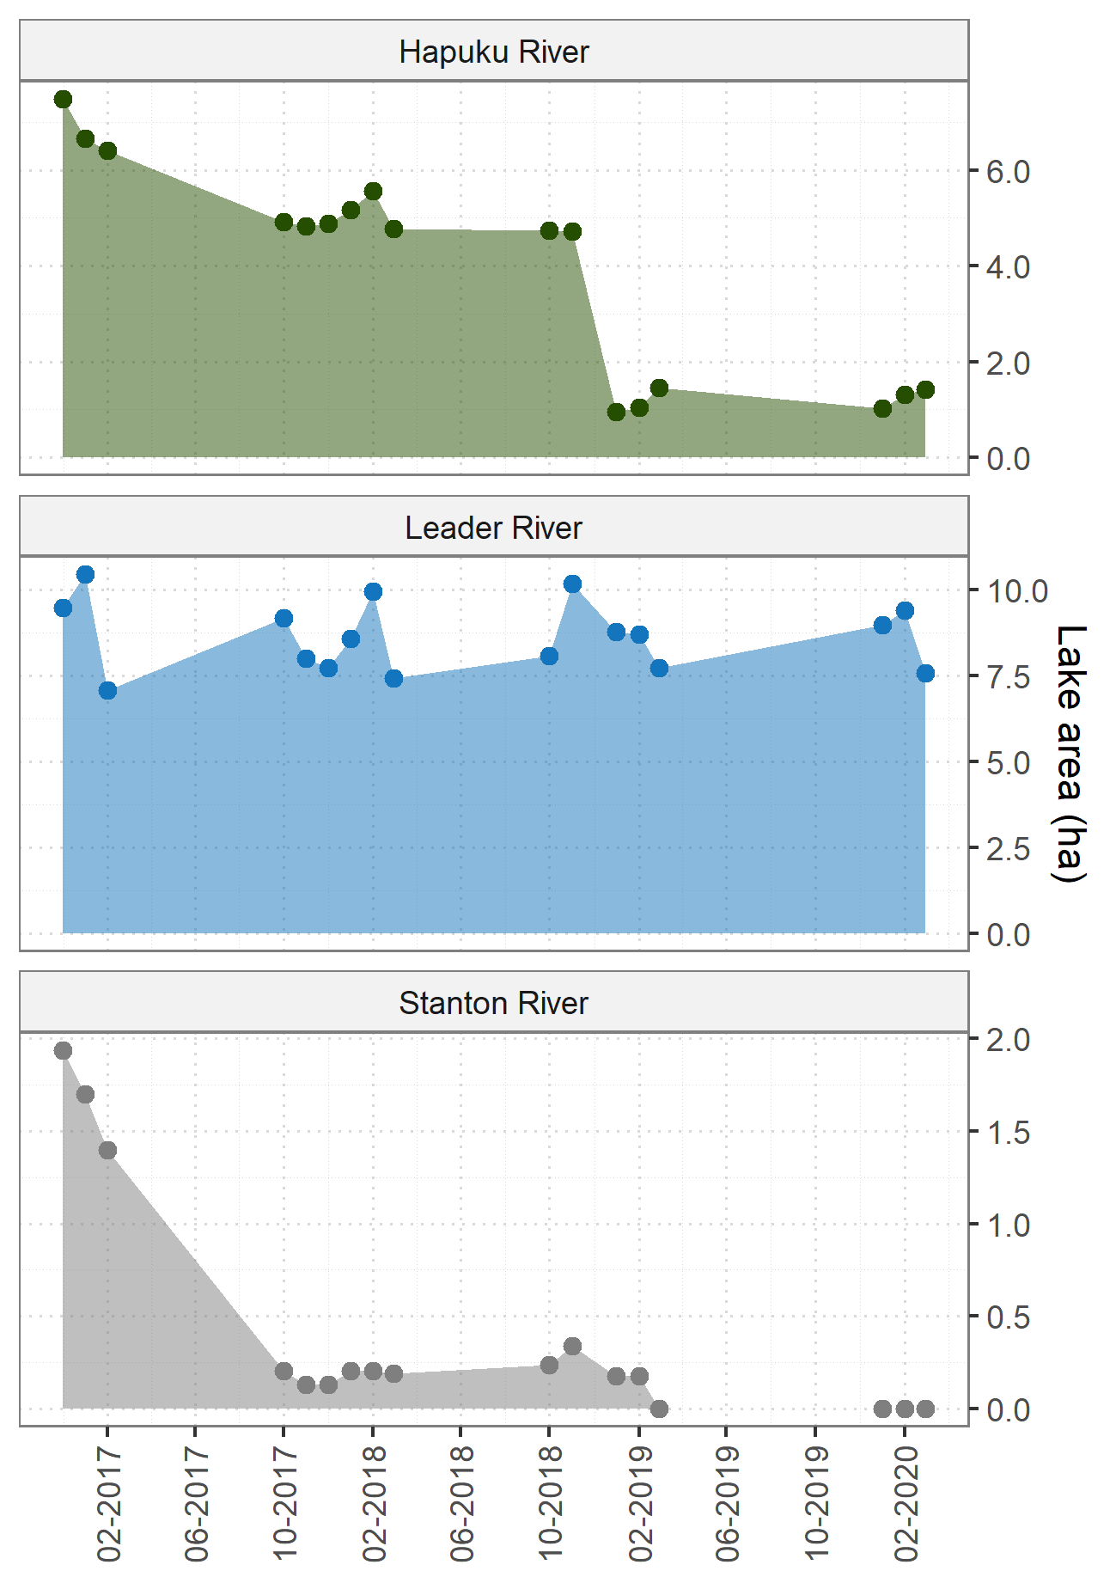
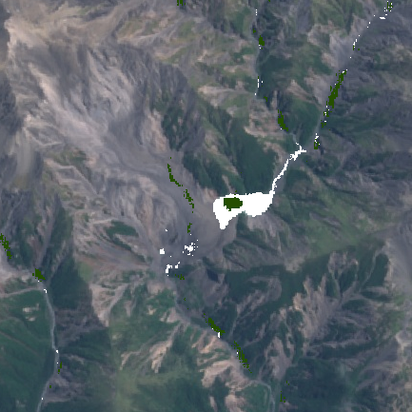
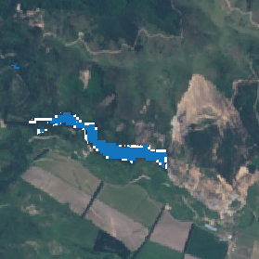
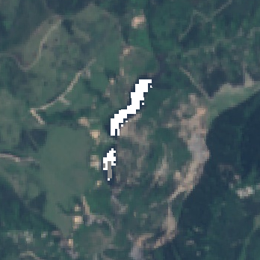
Results
Example landslide-dammed lakes time series. White areas represent the state of the dammed lake immediately after the earthquake, and colored areas its state at the latest date detected.
Key findings:
The fast computing capabilities of GEE allowed a comprehensive mapping of landslide-dammed lakes in large regions, which eases the identification of potential risk areas at a glance.
1
2
3
Monitoring the evolution of large landslide-dammed lakes is possible for relatively flatter terrain.
The methods limitation include smaller sized lakes in steep terrains, due to the Sentinel-2 spatial resolution and topographical shadows.

Slide 7


Thank you!
Acknowledgements
This research is supported by the Austrian Academy of Sciences (ÖAW) through the project RiCoLa (Detection and analysis of landslide-induced river course changes and lake formation) and by the New Zealand Ministry of Business, Innovation and Employment through the project STEC (Cost-effective targeting of erosion control to protect soil and water values; contract no. 1819-38-010 J).
Also check…
Landslide dam susceptibility in the Austrian Alps inferred from modelled landslides, potential valley damming and lake formation
Anne-Laure Argentin, Günther Prasicek, Jörg Robl, Daniel Hölbling, Lorena Abad, and Zahra Dabiri
Tue, 05 May, 14:00–15:45
Observation and Reporting of Landforms and Landscape Dynamics by Citizens
Daniel Hölbling, Sabine Hennig, Lorena Abad, Simon Ecke, and Dirk Tiede
Mon, 04 May, 10:45–12:30
Assessing the impact of mass movements on alpine trails and huts using EO data
Florian Albrecht, Daniel Hölbling, Lorena Abad, Zahra Dabiri, Gerald Reischenböck, Gabriela Scheierl, Tobias Hipp, Hannes Resch, and Gernot Resch
Thu, 07 May, 14:00–15:45
http://landslides-and-rivers.sbg.ac.at/
References
[1] Donchyts, G. et al. (2016) ‘A 30 m resolution surface water mask including estimation of positional and thematic differences using Landsat 8, SRTM and OpenStreetMap: A case study in the Murray-Darling basin, Australia’, Remote Sensing, 8(5). doi: 10.3390/rs8050386.
[2] Dellow, S. et al. (2017) ‘Landslides caused by the Mw7. 8 Kaikoura Earthquake and the Immediate Response’, Bulletin of the New Zealand Society for Earthquake Engineering, 50(2), pp. 106–116. doi: 10.5459/bnzsee.50.2.106-116.
Icons from Microsoft Office and Flaticon made by Freepik and Good Ware.

